Slide 1

YCAT – Yaesu Computer Assisted Transceiver
Yaesu HF Radio CAT control demo
Steve Ollmann – KC5NK

Slide 2

Why YCAT?
Started as a way of learning my FT-891 with limited menus
Control and Monitor radio over enhanced USB serial interface
Used to control most common features of the radio
Provide User defined functionality
Access to all meters at once
Program VFO memories
Simple logbook, exports ADIF format (Even POTA)
User selectable mapping views (requires vendor Keys for most maps)

Slide 3
YCAT - Origins
Bought FT-891 at beginning of Covid for “keeping in touch” with the world
Noticed it had serial interface (CAT) which is what I do along with GPS
Dabbled turning rig on and off, then added more features to learn about the FT-891.
Eventually, it started taking form as a Rig Control application
Started adding new radios (FT-991a, FT-dx10, FT-710, FT-dx3000, etc.)
Reluctantly added a QSO logger and added POTA features for drag-n-drop into POTA.app
Mapping allows me to find my own grid square without GPS and find bearing to DX stations if I needed to point a beam towards them.

Slide 4
What is YCAT?
Rig Control
Customizable buttons
All Meters display (relocatable)
RIG / GPS / SDR and WSJT-x interfaces
GPS computes 6-digit grid and PC time
SDR interface works with RSP-dx, etc.
VFO Memory read/write and file read/save
HamDB and QRZ call sign lookup
Voice Memory record/verify/send
CW control, memory record/send
Microphone equalizer settings
Logger (regular / POTA)
POTA spot viewing (filtering)
Mapping with helpful features
Spectrum Scope management for supported rigs
Windows 32-bit application

Slide 5
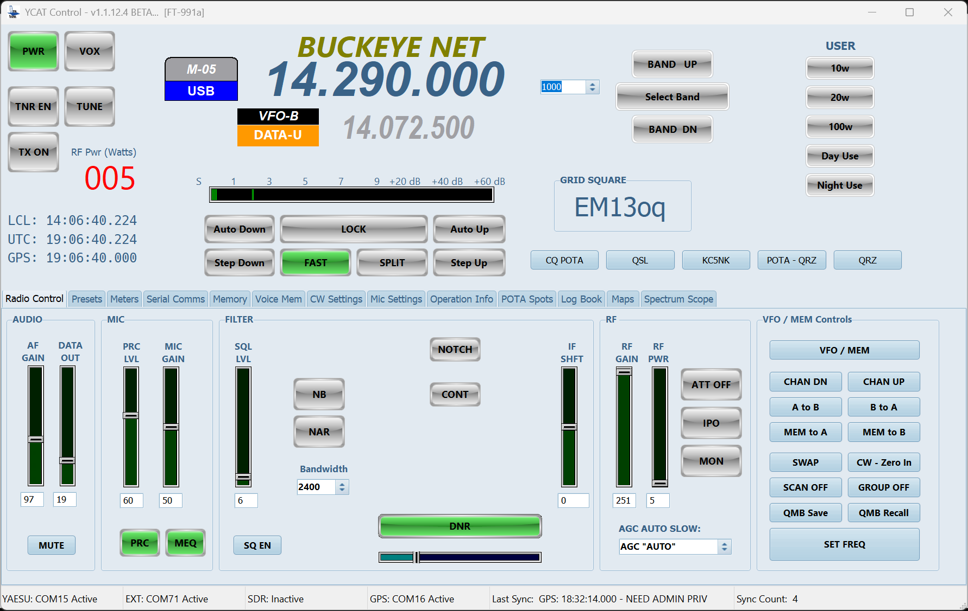
YCAT – Main Operating Screen

Slide 6
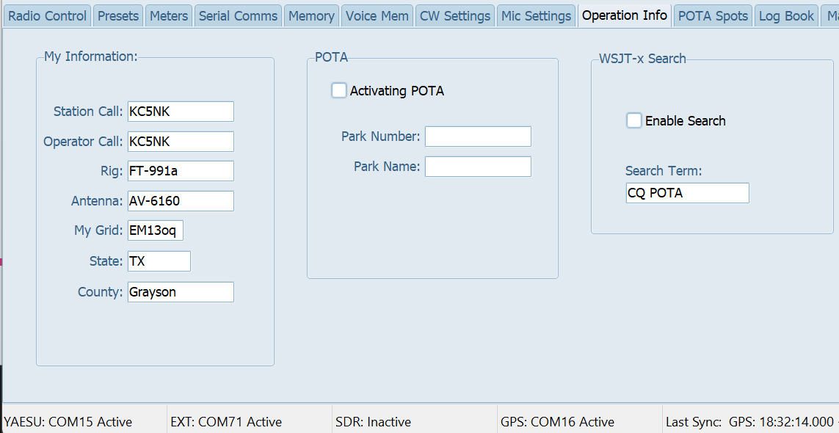
YCAT – Operation Info (Default tab)
My Information
Enter station call sign
Rig field should auto configure after radio starts communicating
Antenna field is optional
My Grid: this field will auto populate with a GPS dongle. Manually enter if no GPS configured.
POTA
Check if activating POTA, enter park number and park name
WSJT-x Search
Check “Enable Search” for audible beep for decoding “Search Term”

Slide 7
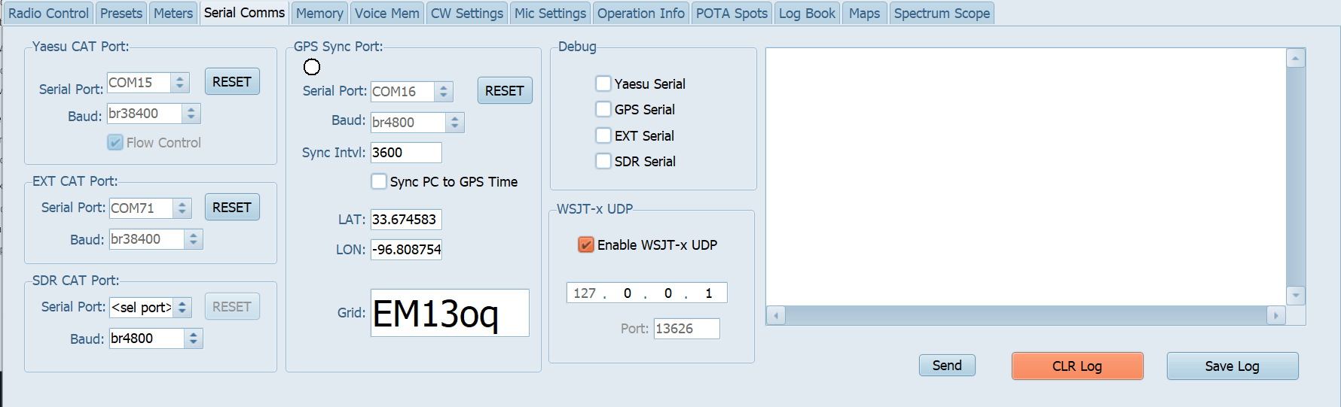
YCAT – Serial Comms
Yaesu CAT Serial
Use Enhanced port
EXT CAT (WSJT-X)
Requires virtual serial cable
In this case (COM70 / COM71)
SDR CAT – emulates Kenwood TS480
Requires virtual serial cable
2-way communication with SDR Play / SDR Uno
GPS Serial
Sync PC Time with GPS Time (requires YCAT to run as Admin)
Shows current Latitude / Longitude and 6-digit Grid Square
WSJT-X UDP
Allows receiving WSJT-X log information for YCAT logger
Must match IP and Port number.
Supports Multi-Cast

Slide 8
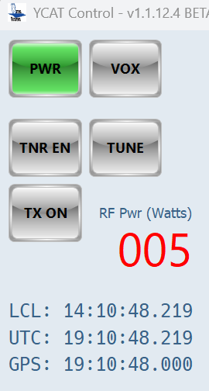
YCAT – Main Screen
Many indicators are also controls
Power – turns radio ON/OFF
TNR EN – turns tuner ON/OFF
TUNE – initiates a tune cycle
TX ON – “keys” and “unkeys” transmitter
RF Pwr (watts) – TX power setting
Time settings
LCL – shows local time from PC
UTC – shows UTC time from PC
GPS – shows GPS time (UTC)
Requires optional GPS receiver

Slide 9
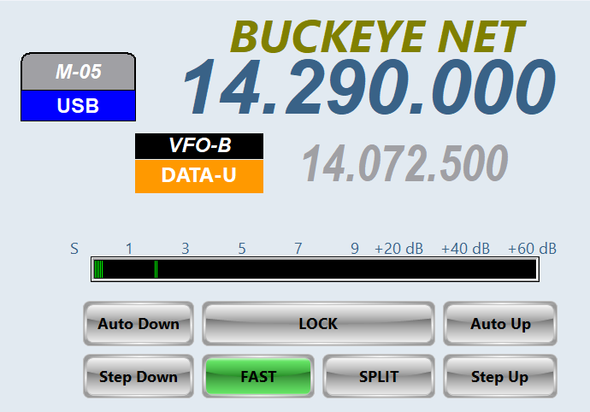
YCAT – Main Screen
VFO A Frequency
Memory Tag – user defined
Mem Channel indicator
VFO B Frequency
VFO Controls
Auto Down – hold to decrease VFO A
Auto Up – hold to increase VFO A
LOCK – Locks the VFO
Step Down – press to decrement VFO
Step Up – press to increment VFO
FINE (FAST) – controls VFO steps
SPLIT – turns VFO A/B split mode on/off
S-meter – shows radio S readings (with peak indicator)

Slide 10
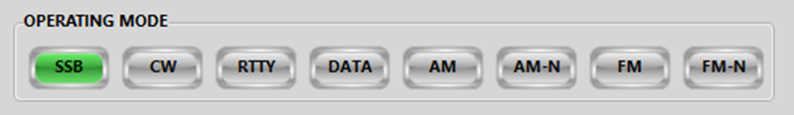
YCAT – Main Screen Modes (Legacy)
Mode select
SSB
CW
RTTY
DATA
AM
AM Narrow
FM
FM Narrow
C4FM (FT-991 only)

Slide 11

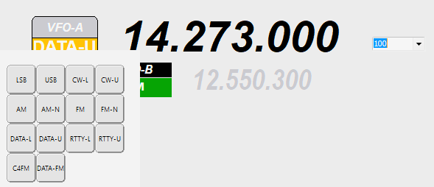
YCAT – Mode Selection (new)
Click mode section under VFO-A to bring up menu
Select Mode and menu closes automatically
Similar to FT-710 screen operation
Works the same for all rigs

Slide 12
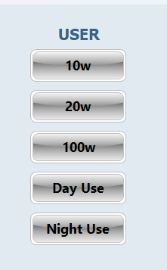
YCAT - User Defined Buttons (CAT COMMANDS)
Five ( 5 ) buttons are available for the user to add their own features.
Choose whether buttons are visible, what text to display, and the underlying CAT commands
CAT Commands can be concatenated
Reference the Yaesu CAT Manual for your rig.
Configure in PRESETS tab

Slide 13

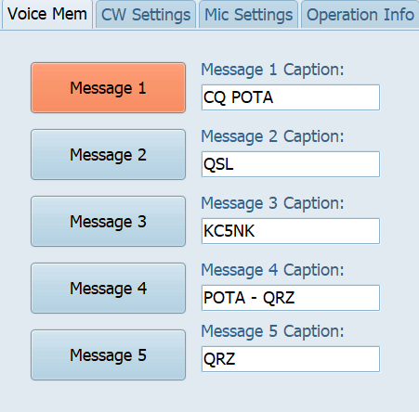
YCAT – Voice Memory
Buttons have customizable text
Configured in Voice Mem tab
Defaults to SEND
Can Record, Verify, and Send when pressed (Voice Mem Tab)

Slide 14
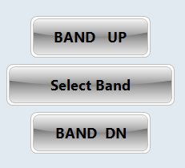
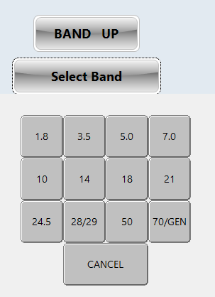
YCAT – Band Selection
Simple Band Up and Band Down buttons
Select Band button allows choosing the band to go to:
Menu stays up until you choose band or cancel

Slide 15
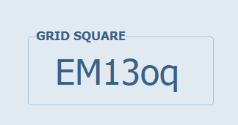
YCAT – Main : Grid Square
When GPS is connected it automatically computes a 6-digit grid square
Auto populates Operation Info – Grid Square field
Syncs radio clock automatically
Syncs PC clock (YCAT must be run as Admin for write to system clock permission)

Slide 16
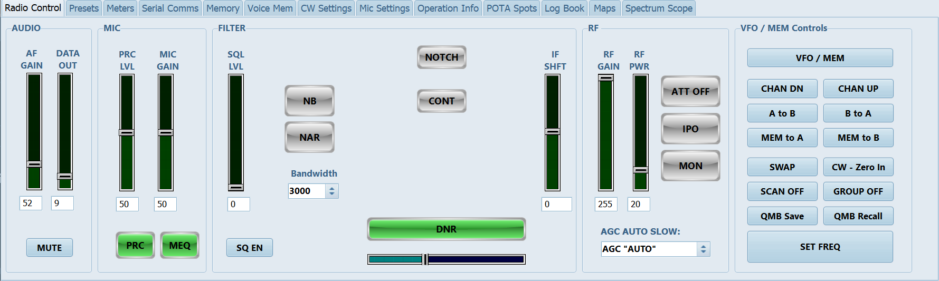
YCAT – Radio Control Tab
Organized Audio to RF from left to right
VFO / Memory operation on the furthest right-hand side

Slide 17
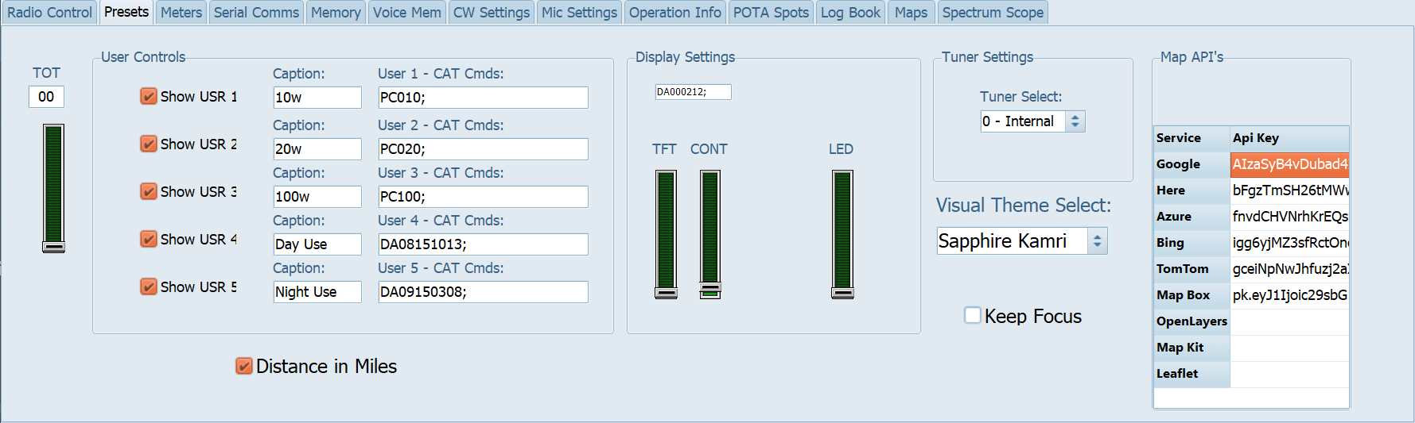
YCAT – Presets Tab
TOT – TX Timeout Timer
User Controls
Display Settings
Tuner Settings
Visual Theme
Mapping API Key storage.

Slide 18
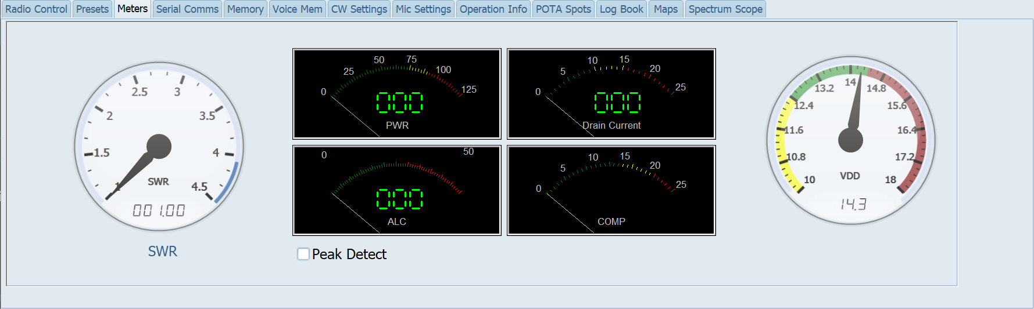
YCAT – Meters Tab
Display all meters at once
Voltage is real-time, all others are active during transmission.

Slide 19
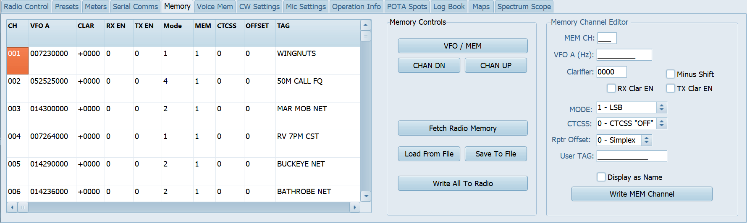
YCAT – Memory Tab
Programming for VFO Memory with “TAGS”
Read/Write with your Rig
Read/Write with a file

Slide 20
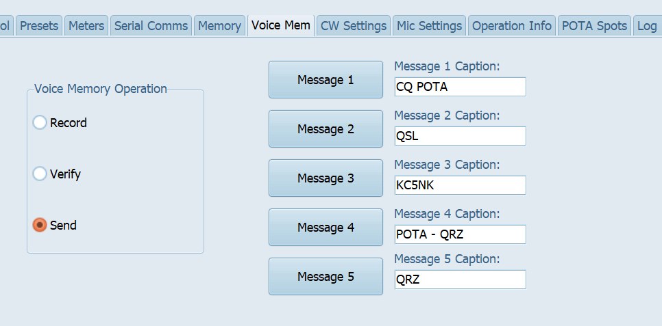
YCAT – Voice Memory Tab
Allows user to create voice memory, customize buttons and control record, verify and send behavior for the five ( 5 ) voice memories in the Yaesu radio.

Slide 21
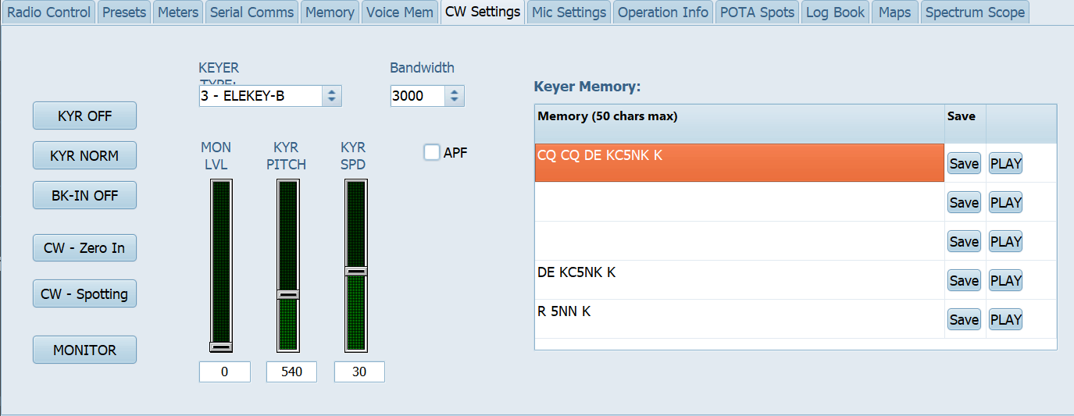
YCAT – CW Settings Tab
Used for configure Yaesu radio CW Memory parameters
Customize CW memory slots, adjust MON level, Keyer Pitch and Keyer Speed.

Slide 22
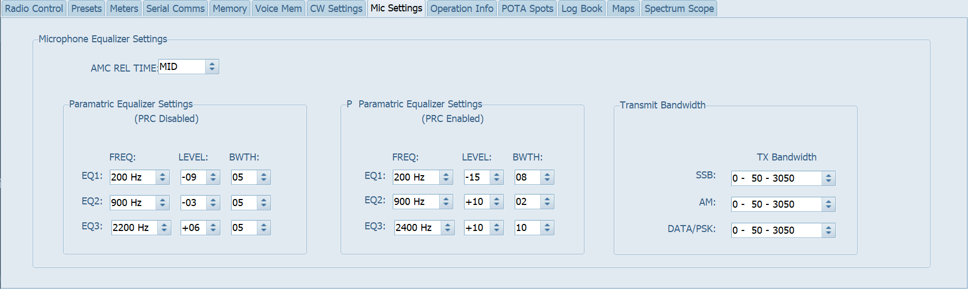
YCAT – Mic Settings Tab
Set Mic Equalizer settings for PRC disabled / PRC enabled modes
Set Transmit bandwidth settings for SSB, AM, and Data

Slide 23
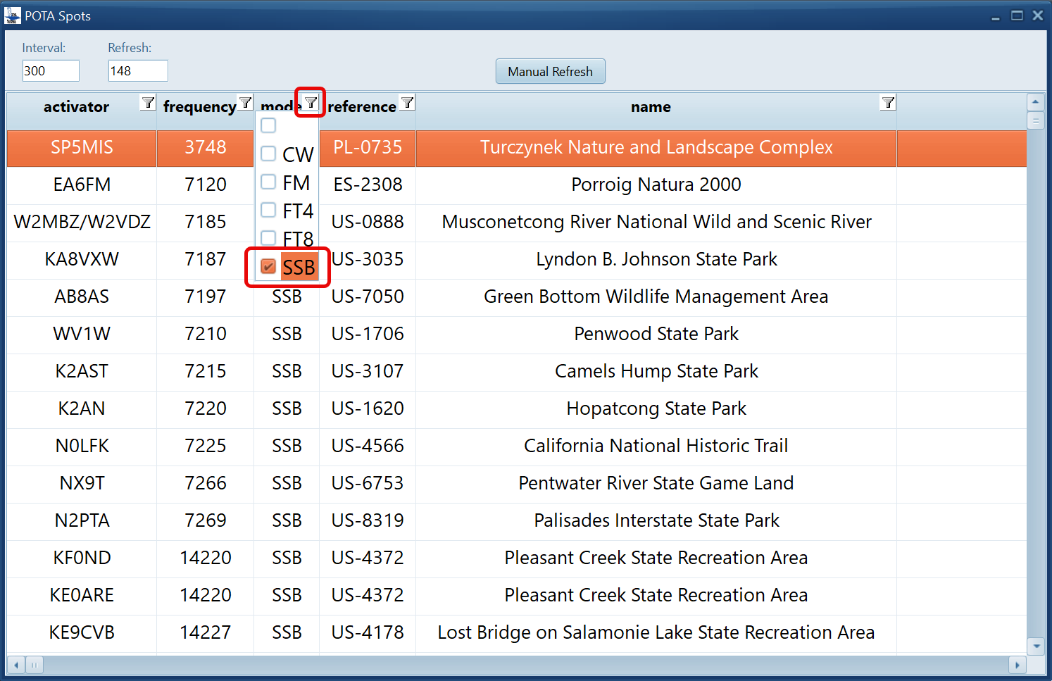
YCAT – POTA Spots Tab
Requires internet connection
Press “Show POTA Spots” button
POTA spots spreadsheet pops up
Filter by Mode is most helpful
Scroll or select a row tunes VFO
Auto populates in Log Book tab

Slide 24
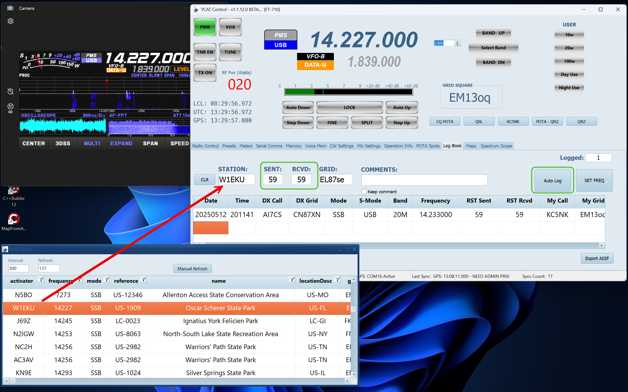
YCAT – Logging from POTA Spots
Clicking on a row in POTA Spots grid will auto populate Log Book

Slide 25
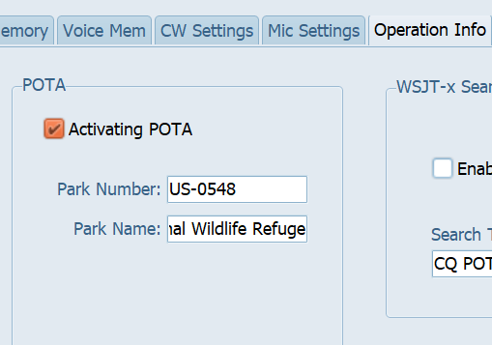
YCAT – POTA Logbook Setup
Manually enter your park information in POTA section of OPERATION INFO tab

Slide 26
YCAT - POTA Logbook Setup, continued
Switch to Log Book tab
Call sign lookup choices are: None, HamDB, and QRZ
Notice addition of visual cues for park information
Enter call sign, if Call Lookup is enabled, a popup will show DX call information

Slide 27
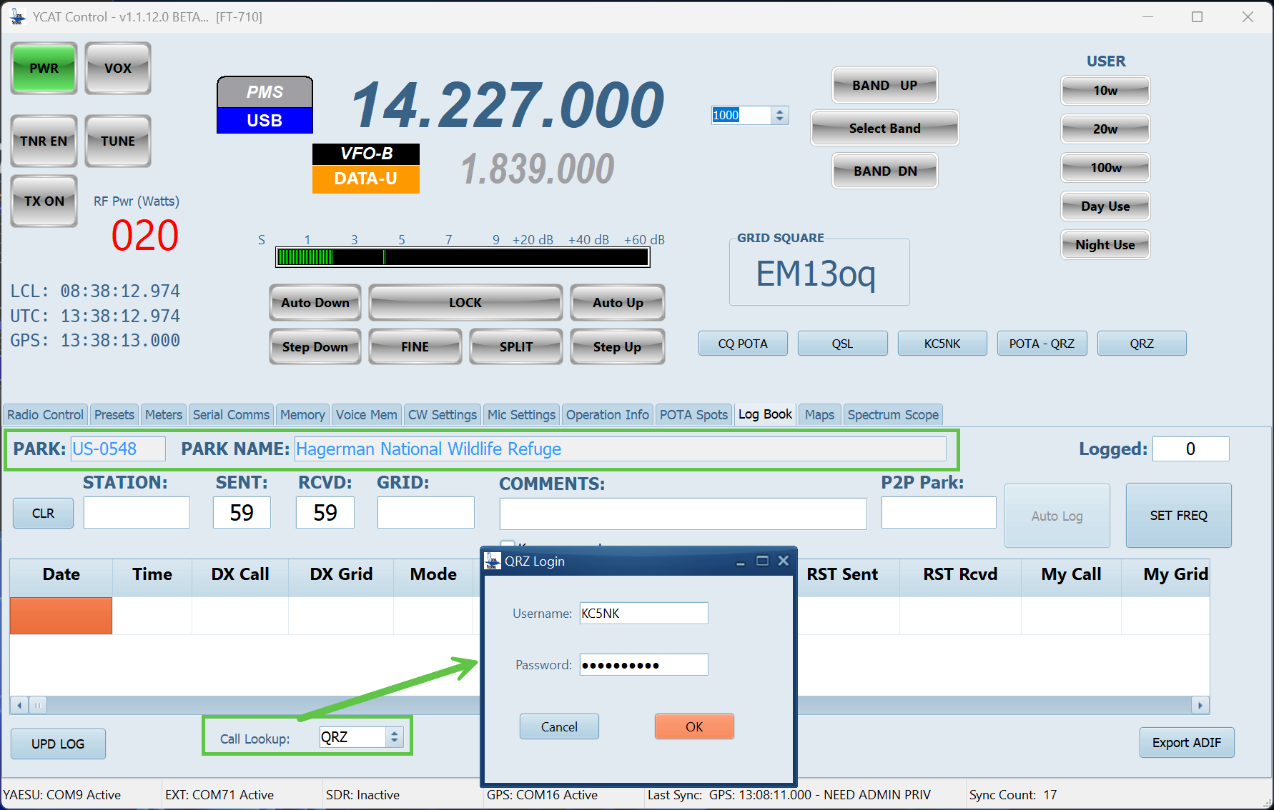
YCAT – POTA Logging w/callsign lookup

Slide 28
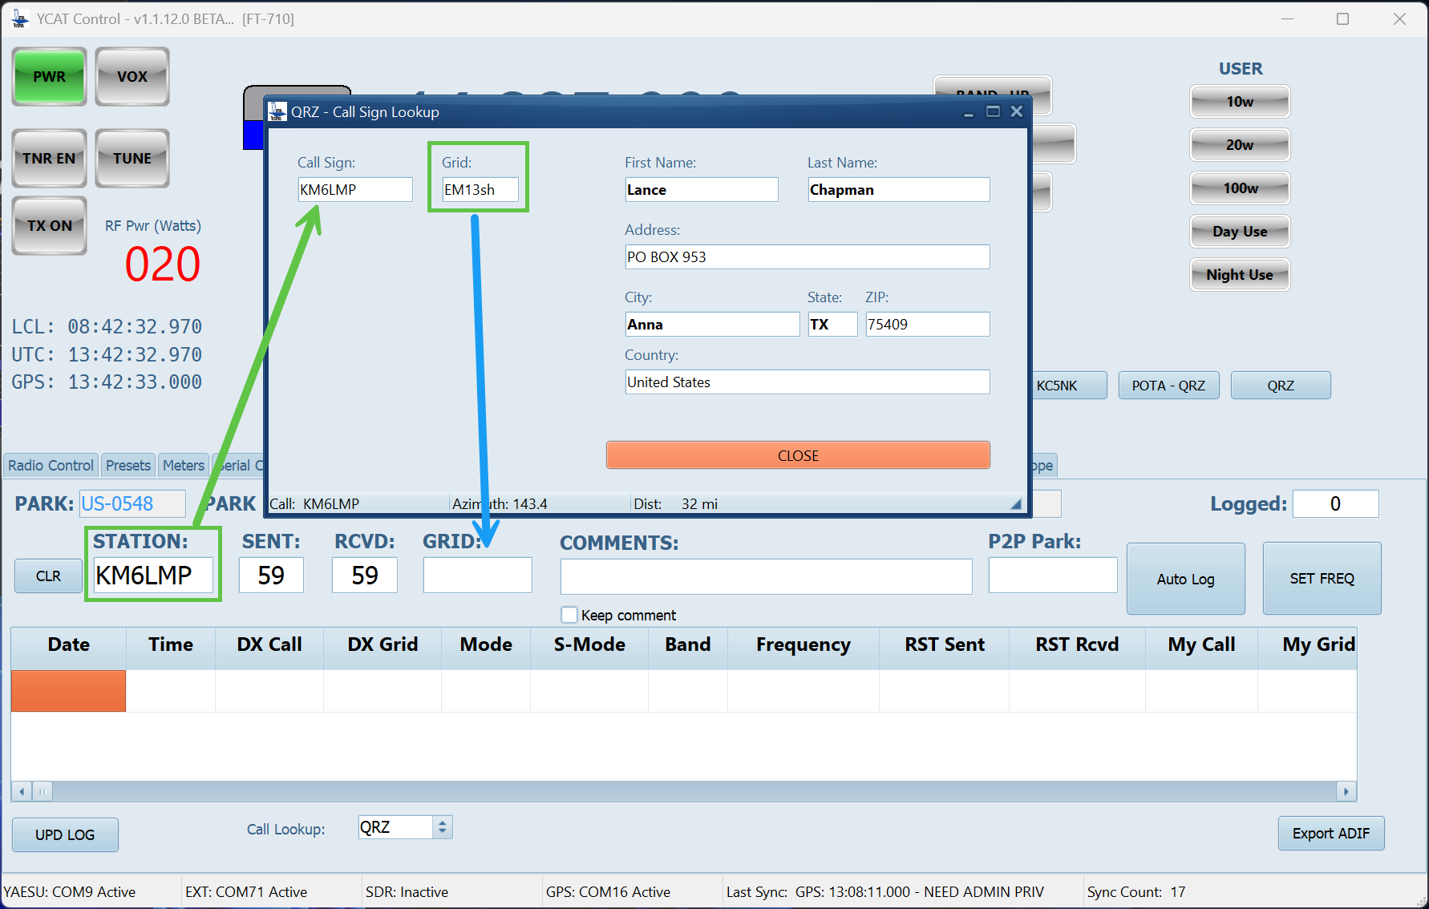
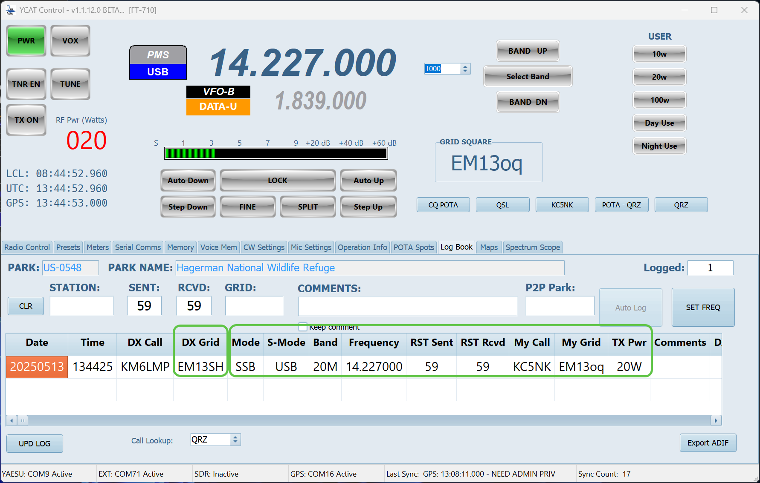
YCAT – POTA Logging

Slide 29
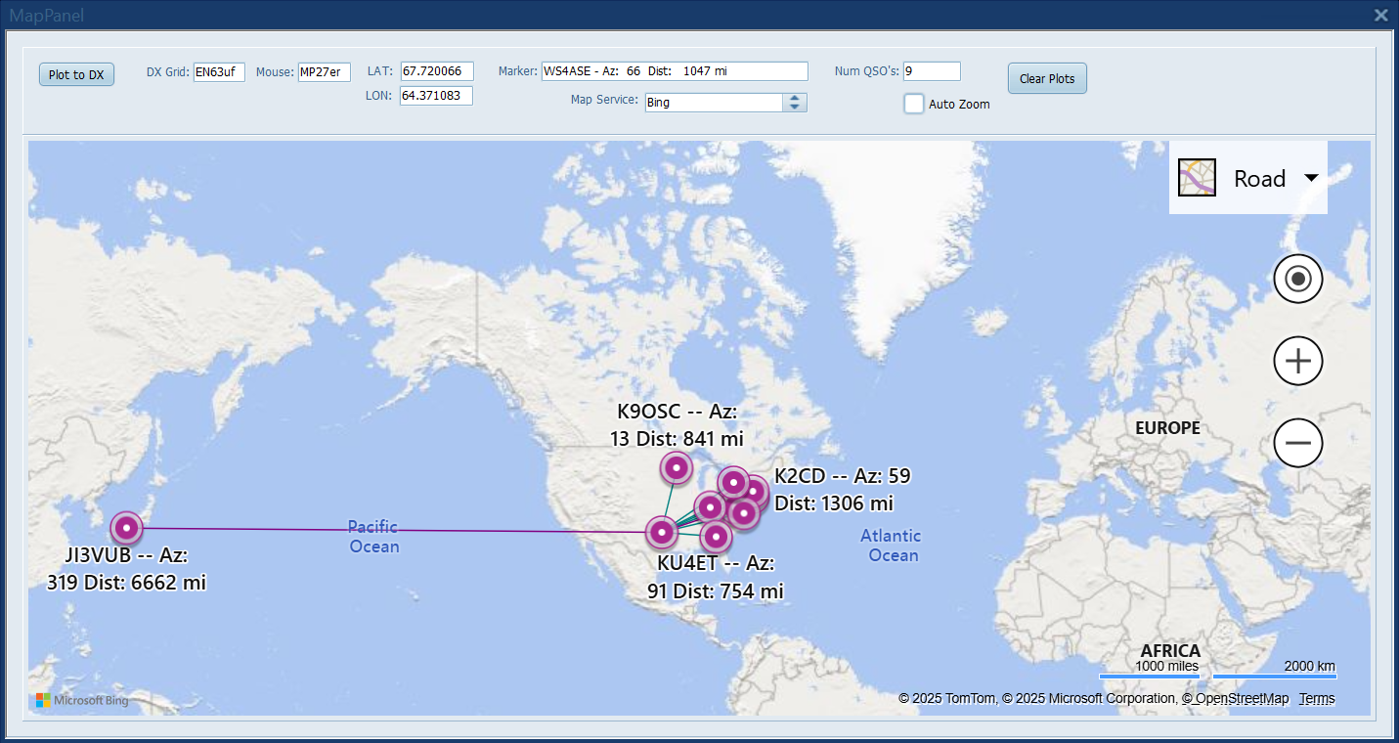
YCAT – Contact Mapping
View contacts on Maps tab
Maps tab can be undocked
Relocatable / resizable
Free mapping – OpenLayers
Can choose other with API Key from mapping vendor

Slide 30
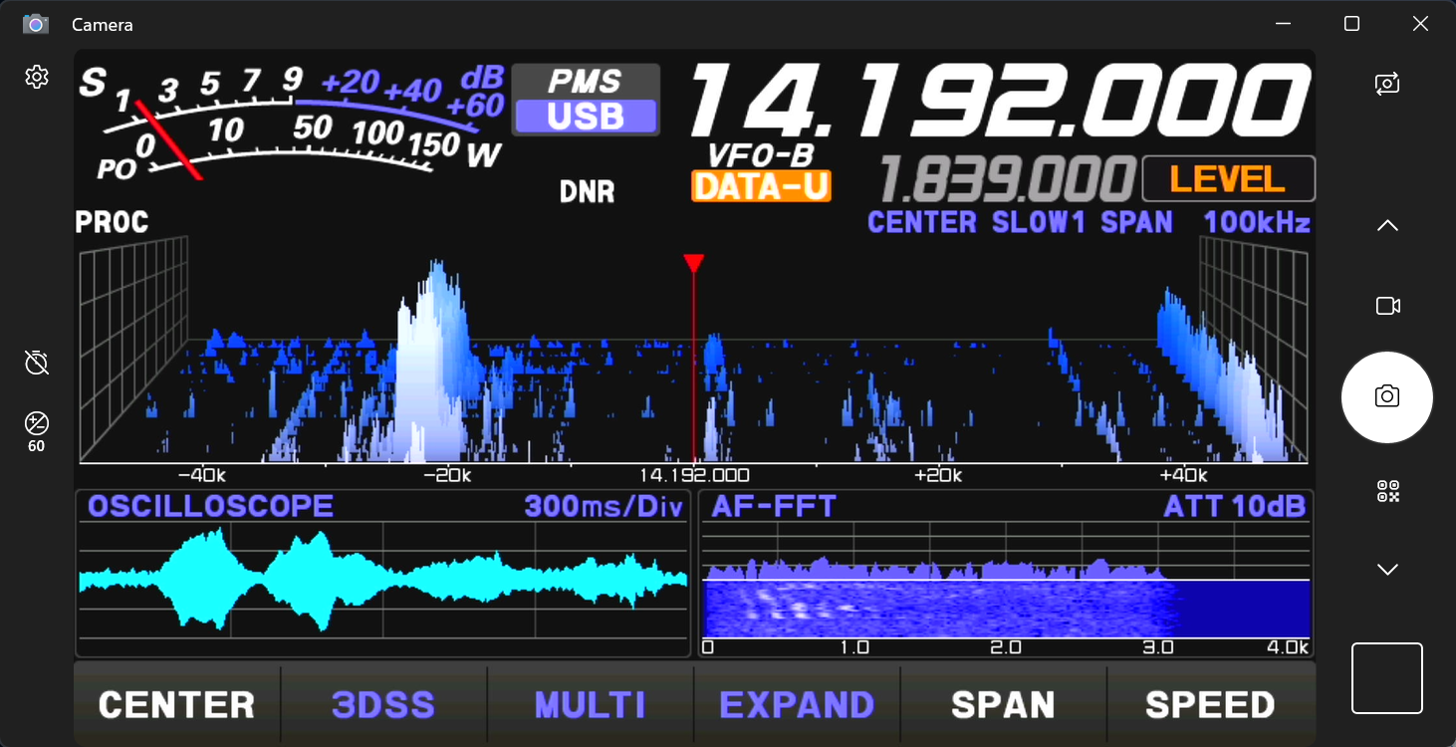
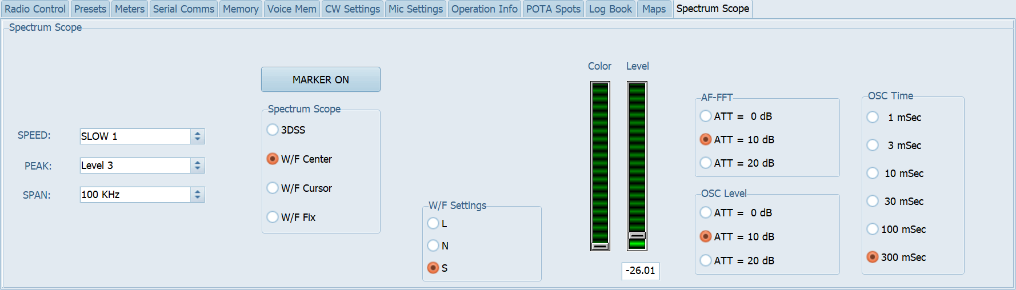
YCAT – Spectrum Scope
Limited to FT-710 and FT-dx10 radios
Allows controlling rig display from YCAT
Helpful if using DVI-D to USB Video Capture device

Slide 31
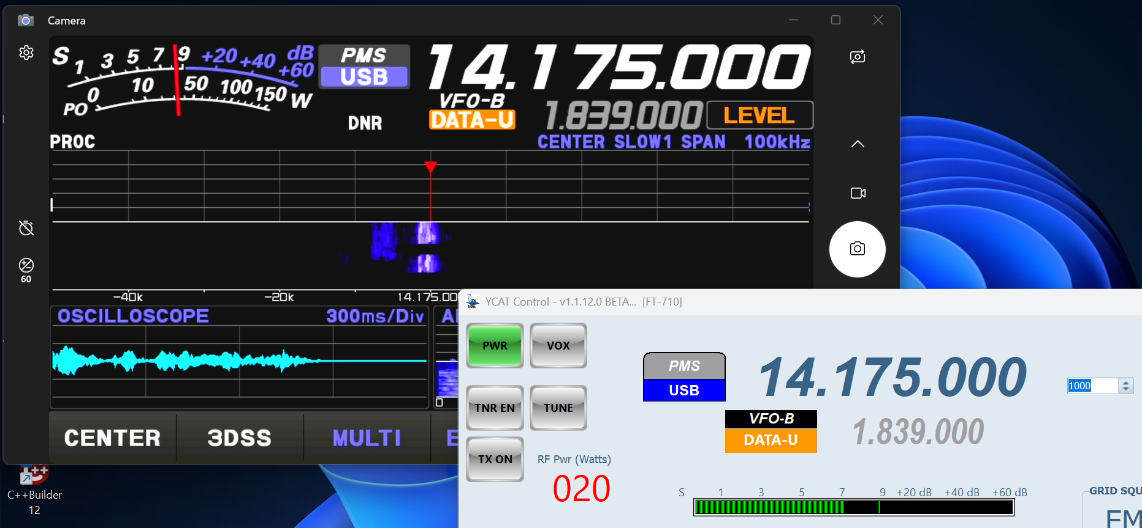
YCAT – Example of PMS
Example of Extra class operator transmitting on band edge for Advanced class
When setting rig for Preferred Memory it keeps you within the limits you set.
I tried tuning to QSO but my lower limit is 14.175 MHz

Slide 32
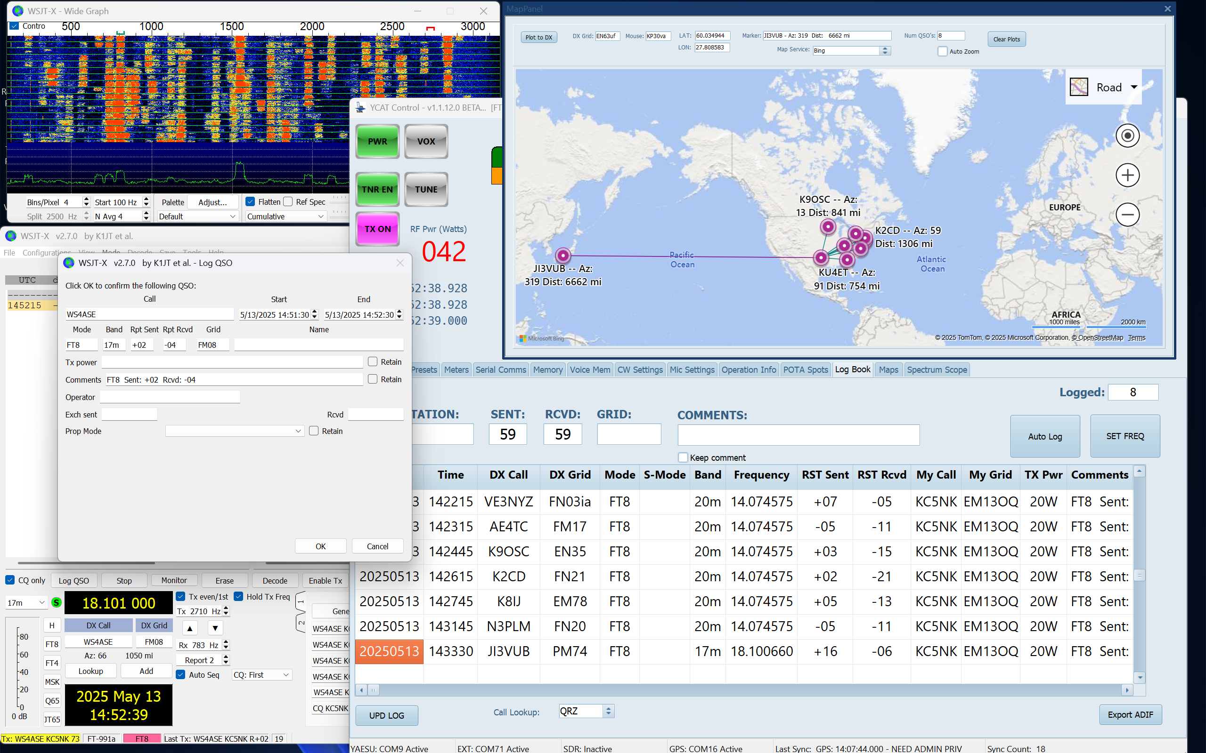
YCAT - FT8 Operation
Laptop display with WSJT-x, YCAT mapping / Logbook
Requires a virtual serial cable between WSJT-x and YCAT’s EXT Serial interface.

Slide 33

YCAT – Questions / answer
Open for Q/A

